Slide 1
The week of the department of “Mechanization of agriculture” The competition in English “Do you know your technical school?”
The first course, group 1-2.

Slide 2
The 1st contest “Warm-up” «Разминка»

Slide 3
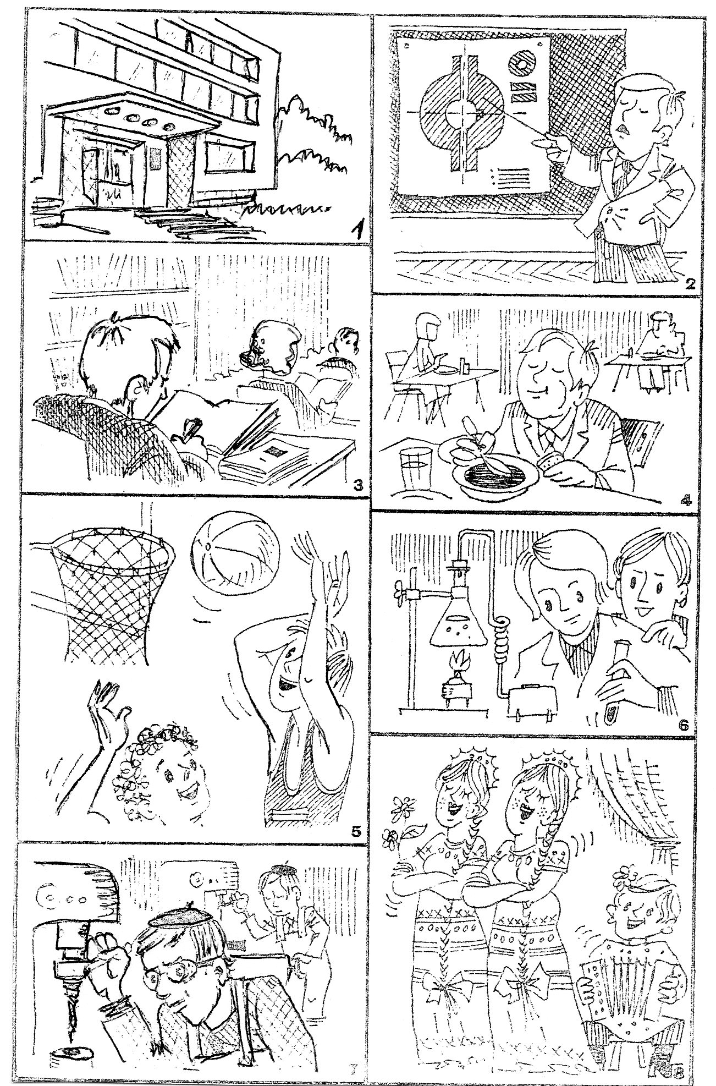
The 2nd contest
“Make up
the story
on the pictures”
«Составить
рассказ по
картинкам»

Slide 4
The 3rd contest is “The captain’s contest”.
About “Our technical school” retell us team “ ”, and about “My department” retell us the team “ ”.
About “Our technical school” retell us team “The Spark”; (О «Нашем техникуме» расскажет команда “The Spark”);
About “My department” retell us the team “Top gear”. (О «Моем отделении» расскажет команда “Top gear”. )

Slide 5
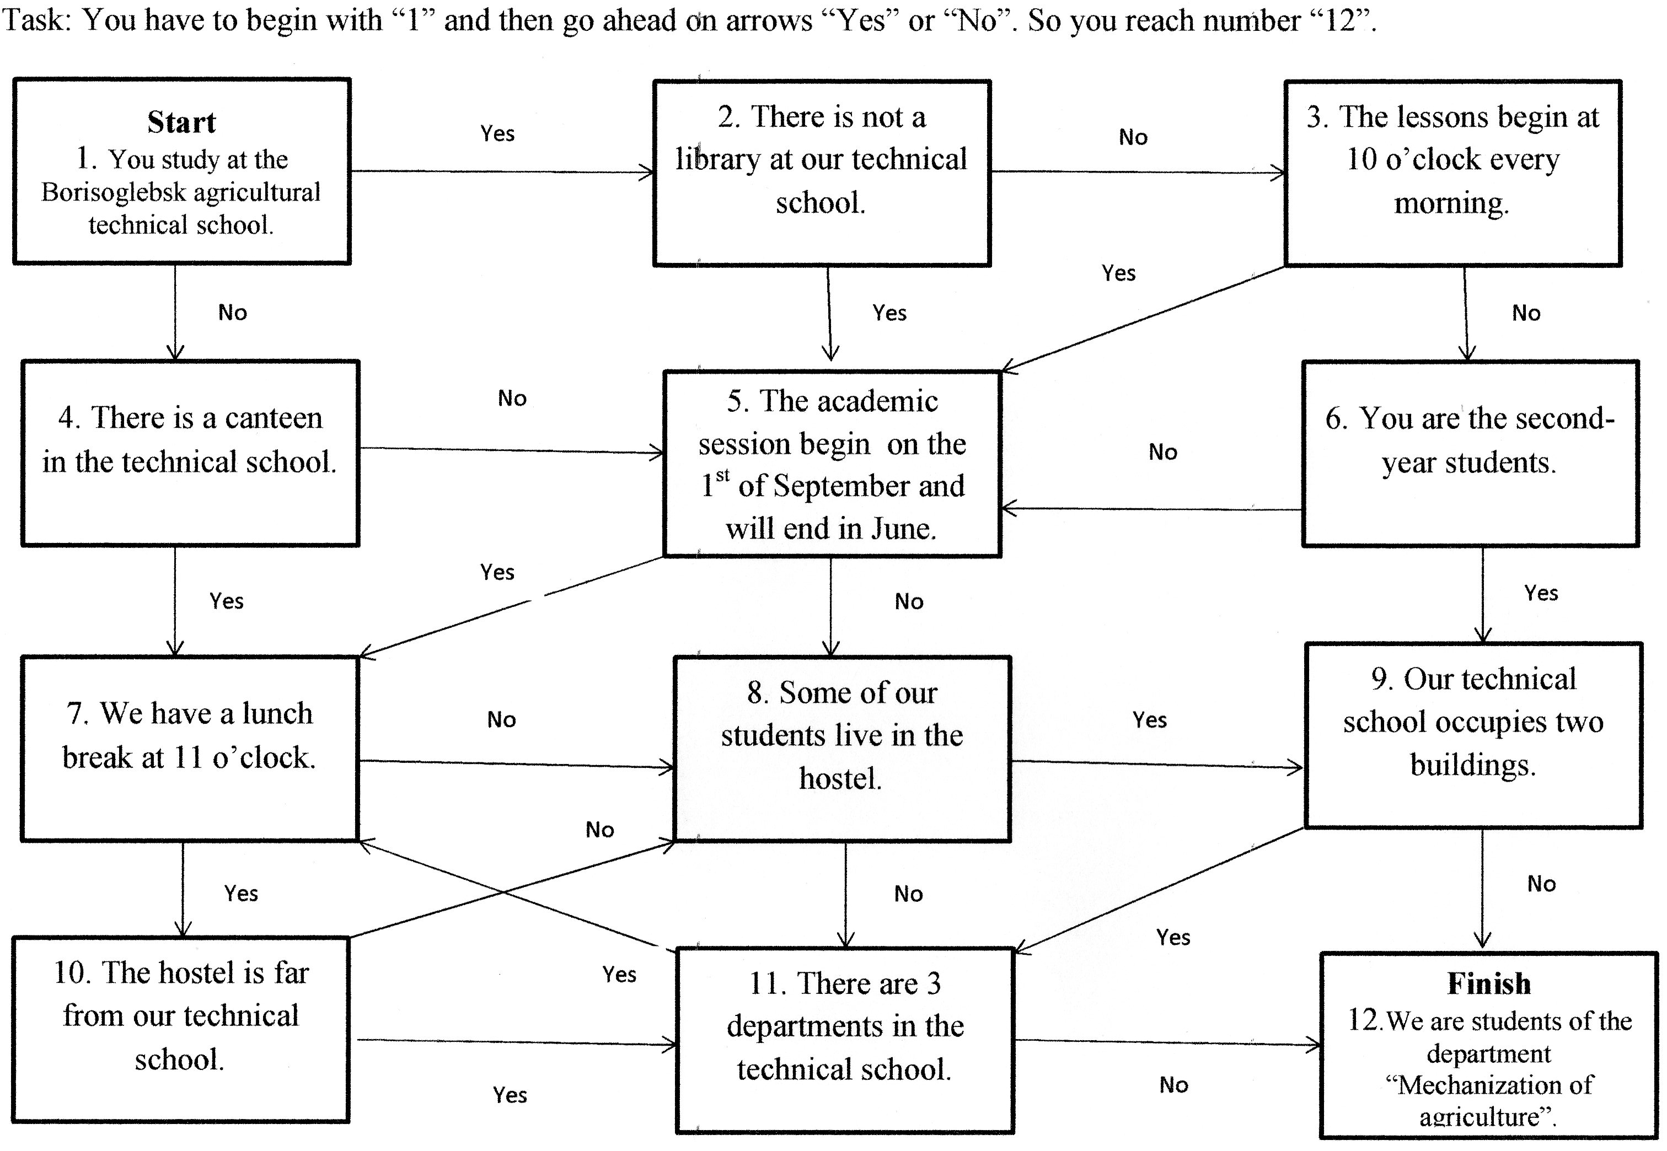

Slide 6
Thank you for attention!

